Slide 1
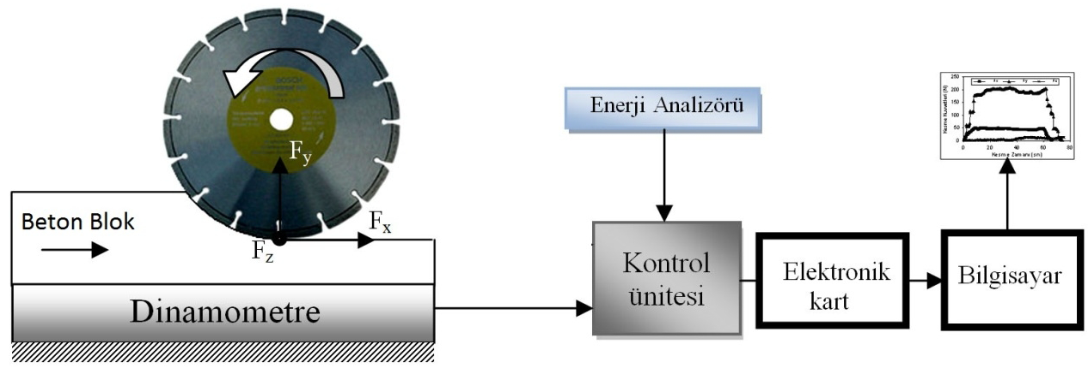
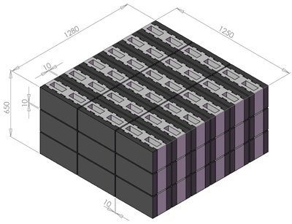
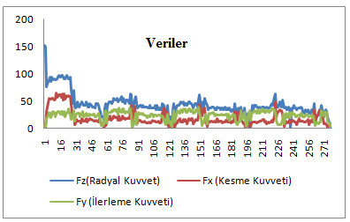
HARRAN ÜNİVERSİTESİ
Mühendislik Fakültesi
Endüstri Mühendisliği Bölümü
MAYIS 2022
Poster Başlığı
Adı SOYADI
ÖZET
Text in Calibri, 40 points, Bold. Text in Calibri, 40 points, Bold. Text in Calibri, 40 points, Bold. Text in Calibri, 40 points, Bold. Text in Calibri, 40 points, Bold. Text in Calibri, 40 points, Bold. Text in Calibri, 40 points, Bold. Text in Calibri, 40 points, Bold. Text in Calibri, 40 points, Bold. Text in Calibri, 40 points, Bold.
Anahtar Kelimeler: Caption in Calibri, 36 points, bold.
YÖNTEM/MATERYAL ve METOT
Text in Calibri, 40 points, Bold. Text in Calibri, 40 points, Bold. Text in Calibri, 40 points, Bold.. Text in Calibri, 40 points, Bold. Text in Calibri, 40 points, Bold. Text in Calibri, 40 points, Bold.. Text in Calibri, 40 points, Bold. Text in Calibri, 40 points, Bold. Text in Calibri, 40 points, Bold..
AMAÇ/ÖZGÜN DEĞER
Text in Calibri, 40 points, Bold. Text in Calibri, 40 points, Bold. Text in Calibri, 40 points, Bold. Text in Calibri, 40 points, Bold. Text in Calibri, 40 points, Bold. Text in Calibri, 40 points, Bold. Text in Calibri, 40 points, Bold. Text in Calibri, 40 points, Bold. Text in Calibri, 40 points, B
Resim 2. Yazı stili calibri, yazı boyu 38 ve resim 300 dpi kalitesinde olacaktır.
SONUÇ
Text in Calibri, 40 points, Bold. Text in Calibri, 40 points, Bold. Text in Calibri, 40 points, Bold. Text in Calibri, 40 points, Bold. Text in Calibri, 40 points, Bold. Text in Calibri, 40 points, Bold. Text in Calibri, 40 points, Bold. Text in Calibri, 40 points, Bold.
Resim 1. Yazı stili calibri, yazı boyu 38 ve resim 300 dpi kalitesinde olacaktır.
YÖNTEM/MATERYAL ve METOT
Text in Calibri, 40 points, Bold. Text in Calibri, 40 points, Bold. Text in Calibri, 40 points, Bold..
Resim 3. Yazı stili calibri, yazı boyu 38 ve resim 300 dpi kalitesinde olacaktır.
.
REFERANSLAR
Text in Calibri, 40 points, Bold. Text in Calibri, 40 points, Bold. Text in Calibri, 40 points, Bold.

