Slide 1
CIVIL ENGINEERING DEPARTMENT

Slide 2
CIVIL ENGINEERING DEPARTMENT
Mission
Administration
Education
Research Area
Academic Works
Department Events

Slide 3
CIVIL ENGINEERING DEPARTMENT
Head of Department: Prof. Dr. H. Murat ALGIN
Deputy Head
Asst. Prof. Dr. Muhammet Fethi GÜLLÜ
Secretary: Suat MEST
Administration

Slide 4
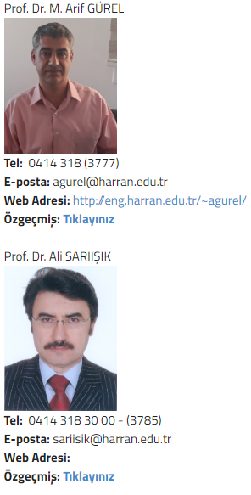
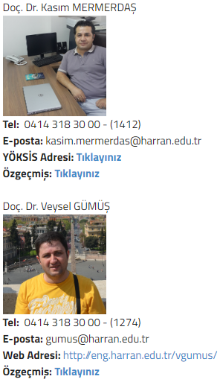
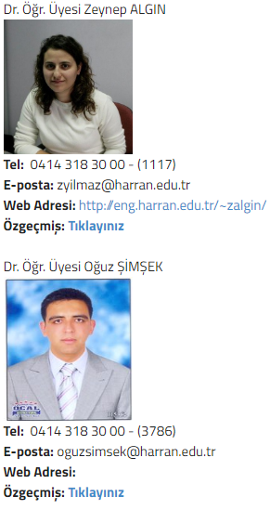
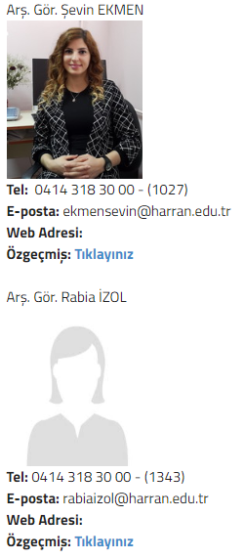
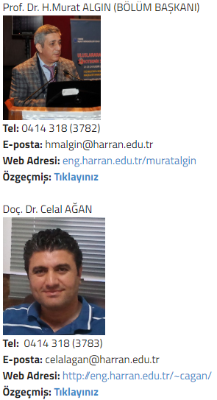
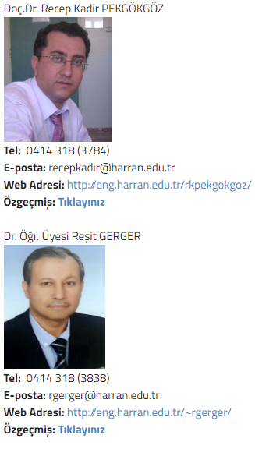
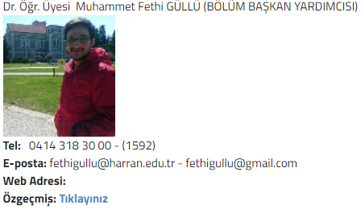
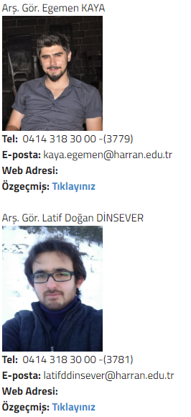
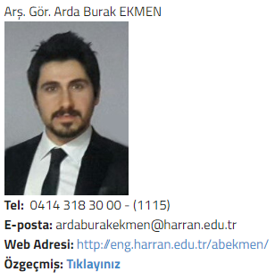
ACADEMIC STAFF

Slide 5
CIVIL ENGINEERING DEPARTMENT
MÜDEK
MÜDEK accreditation of Civil Engineering Department has been extended until 30.09.2021.

Slide 6
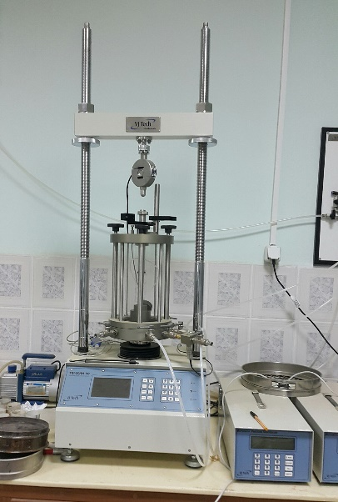
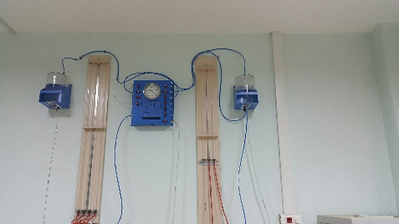
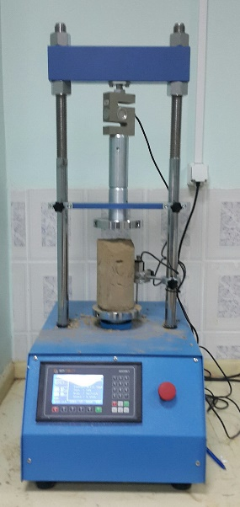
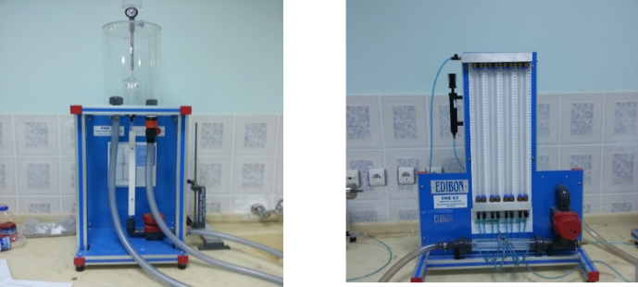
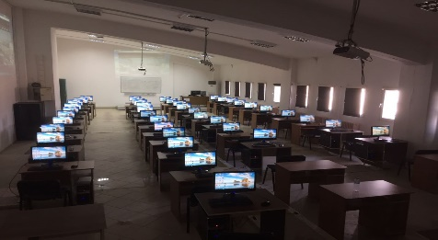
CIVIL ENGINEERING DEPARTMENT
Laboratories

Slide 7
CIVIL ENGINEERING DEPARTMENT
Civil Engineering Club
Civil Engineering Club is active in our department. Students can join the events.

Slide 8
CIVIL ENGINEERING DEPARTMENT
Web Page
http://web.harran.edu.tr/insaat

